Slide 1


Slide 2

Introduction to
Data Science
(IT4142E)

Slide 3
Contents
Lecture 1: Overview of Data Science
Lecture 2: Data crawling and preprocessing
Lecture 3: Data cleaning and integration
Lecture 4: Exploratory data analysis
Lecture 5: Data visualization
Lecture 6: Multivariate data visualization
Lecture 7: Machine learning
Lecture 8: Big data analysis
Lecture 9: Capstone Project guidance
Lecture 10+11: Text, image, graph analysis
Lecture 12: Evaluation of analysis results

Slide 4
1. Assessing performance (1)
How can we make a reliable assessment on the performance of an ML method?
Note that performance of a method often improves as more data are available.
An assessment is more reliable as more data are used to test prediction.
How to choose a good value for a parameter in an ML method?
The performance of a method depends on many factors:
Class distribution
Training size
Representativeness of training data over the whole space,…

Slide 5
Assessing performance (2)
Theoretical evaluation: study some theoretical properties of a method/model with some explicit mathematical proofs.
Learning rate?
How many training instances are enough?
What is the expected accuracy of prediction?
Noise-resistance? …
Experimental evaluation: observe the performance of a method in practical situations, using some datasets and a performance measure. Then make a summary from those experiments.
We will discuss experimental evaluation in this lecture.

Slide 6
Assessing performance (3)
Model assessment: we need to evaluate the performance of a method/model, only based on a given observed dataset D.
Evaluation:
Should be done automatically,
Does not need any help from users.
Evaluation strategies:
To obtain a reliable assessment on performance.
Evaluation measures:
To measure performance quantitatively.

Slide 7
2. Some evaluation techniques
Hold-out
Stratified sampling
Repeated hold-out
Cross-validation
K-fold
Leave-one-out
Bootstrap sampling

Slide 8
Hold-out (random splitting)
The observed dataset D is randomly splitted into 2 non-overlapping subsets:
D_{train}: used for training
D_{test}: used to test performance
Note that:
No instance of D_{test} is used in the training phase.
No instance of D_{train} is used in the test phase.
Popular split: |D_{train}| = (2/3).|D|, |D_{test}| = (1/3).|D|
This technique is suitable when D is of large size.
D_{train} | D_{test}

Slide 9
Stratified sampling
For small or imbalanced datasets, random splitting might result in a training dataset which are not representative.
A class in D_{train} might be empty or have few instances.
We should split D so that the class distribution in D_{train} is similar with that in D.
Stratified sampling fulfills this need:
We randomly split each class of D into 2 parts: one is for D_{train}, and the other is for D_{test}.
for each class:
Note that this technique cannot be applied to regression and unsupervised learning.
D_{train} | D_{test}

Slide 10
Repeated hold-out
We can do hold-out many times, and then take the average result.
Repeat hold-out n times. The i^{th} time will give a performance result p_{i}. The training data for each hold-out should be different from each other.
Take the average p = mean(p₁,…, p_{n}) as the final quality.
Advantages?
Limitations?

Slide 11
Cross-validation
In repeated hold-out: there are overlapping between two training/testing datasets. It might be redundant.
K-fold cross-validation:
Split D into K equal parts which are non-overlapping.
Do K runs (folds): at each run, one part is used for testing and the remaining parts are used for training.
Take the average as the final quality from K individual runs.
Popular choices of K: 10 or 5
It is useful to combine this technique with stratified sampling.
This technique is suitable for small/average datasets.

Slide 12
Leave-one-out cross-validation
It is K-fold cross-validation when K = |D|.
Each testing set consists of only one instance from D.
The remaining is for training.
So all observed instances are exploited as much as possible.
No randomness appears.
But it is expensive, and hence is suitable with small datasets.

Slide 13
Bootstrap sampling
Previous methods do not allow repetitions of an instance in any training part.
Bootstrap sampling:
Assume D having n instances.
Build D_{train} by randomly sampling (with replacement/repetition) n instances from D.
D_{train} is used for the training phase.
D_{test} = D\D_{train} is used for testing quality.
Note that $Dtest = \{z∈D: z∉Dtrain\}$
It can be shown that D_{train} contains nearly 63.2% different instances of D. 36.8% of D are used for testing.
This technique is suitable for small datasets.

Slide 14
3. Model selection
An ML method often has a set of hyperparameters that require us to select suitable values a priori.
Ridge regression: λ
Linear SVM: C
How to choose a good value?
Model selection: given a dataset D, we need to choose a good setting of the hyperparameters in method (model) A such that the function learned by A generalizes well.
A validation set T_{valid} is often used to find a good setting.
It is a subset of D.
A good setting should help the learned function predicts well on T_{valid}. → we are approximating the generalization error on the whole data space by just using small T_{valid}.

Slide 15
Model selection: using hold-out
Given an observed dataset D, we can select a good value for hyperparamerter λ as follows:
Select a finite set S which contains all potential values of λ.
Select a performance measure P.
Randomly split D into 2 non-overlapping subsets: D_{train} and T_{valid}
For each λ ∈ S: train the system given D_{train} and λ. Measure the quality on T_{valid} to get P_{λ}.
Select the best λ* which corresponds to the best P_{λ}.
It is often beneficial to learn again from D given λ* to get a better function.
Hold-out can be replaced with other techniques e.g., sampling, cross-validation.

Slide 16
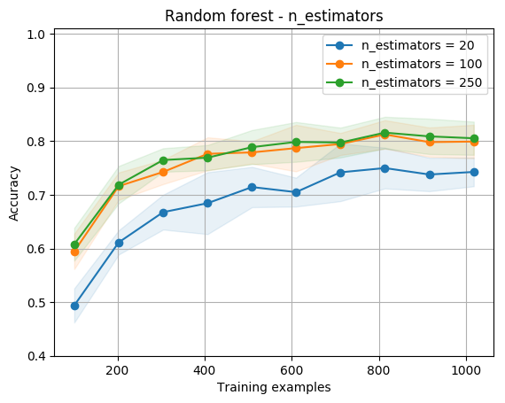

Example: select parameters
Random forest for news classification
Parameter: n_estimates (number of trees)
Dataset: 1135 news, 10 classes, vocabulary of 25199 terms
10-fold cross-validation is used

Slide 17
4. Model assessment and selection
Given an observed dataset D, we need to select a good value for hyperparamerter λ and evaluate the overall performance of a method A:
Select a finite set S which contains all potential values of λ.
Select a performance measure P.
Split D into 3 non-overlapping subsets: D_{train}, T_{valid} and T_{test}
For each λ ∈ S: train the system given D_{train} and λ. Measure the quality on T_{valid} to get P_{λ}.
Select the best λ* which corresponds to the best P_{λ}.
Train the system again from D_{train} ∪ T_{valid} given λ*.
Test performance of the system on T_{test}.
Hold-out can be replaced with other techniques.

Slide 18
5. Performance measures
Accuracy (độ chính xác)
Percentage of correct predictions on testing data.
Efficiency (tính hiệu quả)
The cost in time and storage when learning/prediction.
Robustness (khả năng chống nhiễu)
The ability to reduce possible affects by noises/errors/missings.
Scalability (tính khả mở)
The relation between the performance and training size.
Complexity (độ phức tạp)
The complexity of the learned function.
…

Slide 19
Accuracy
Classification:
$$Accuracy= \frac{number of correct predictions}{Total number of predictions}$$
Regression: (MAE – mean absolute error)
$$MAE= \frac{1}{{|D}_{test}|}\sum_{x∈D_{test}}{|o\left(x\right) − y(x)|}$$
o(x) is the prediction for an instance x.
y(x) is the true value.

Slide 20
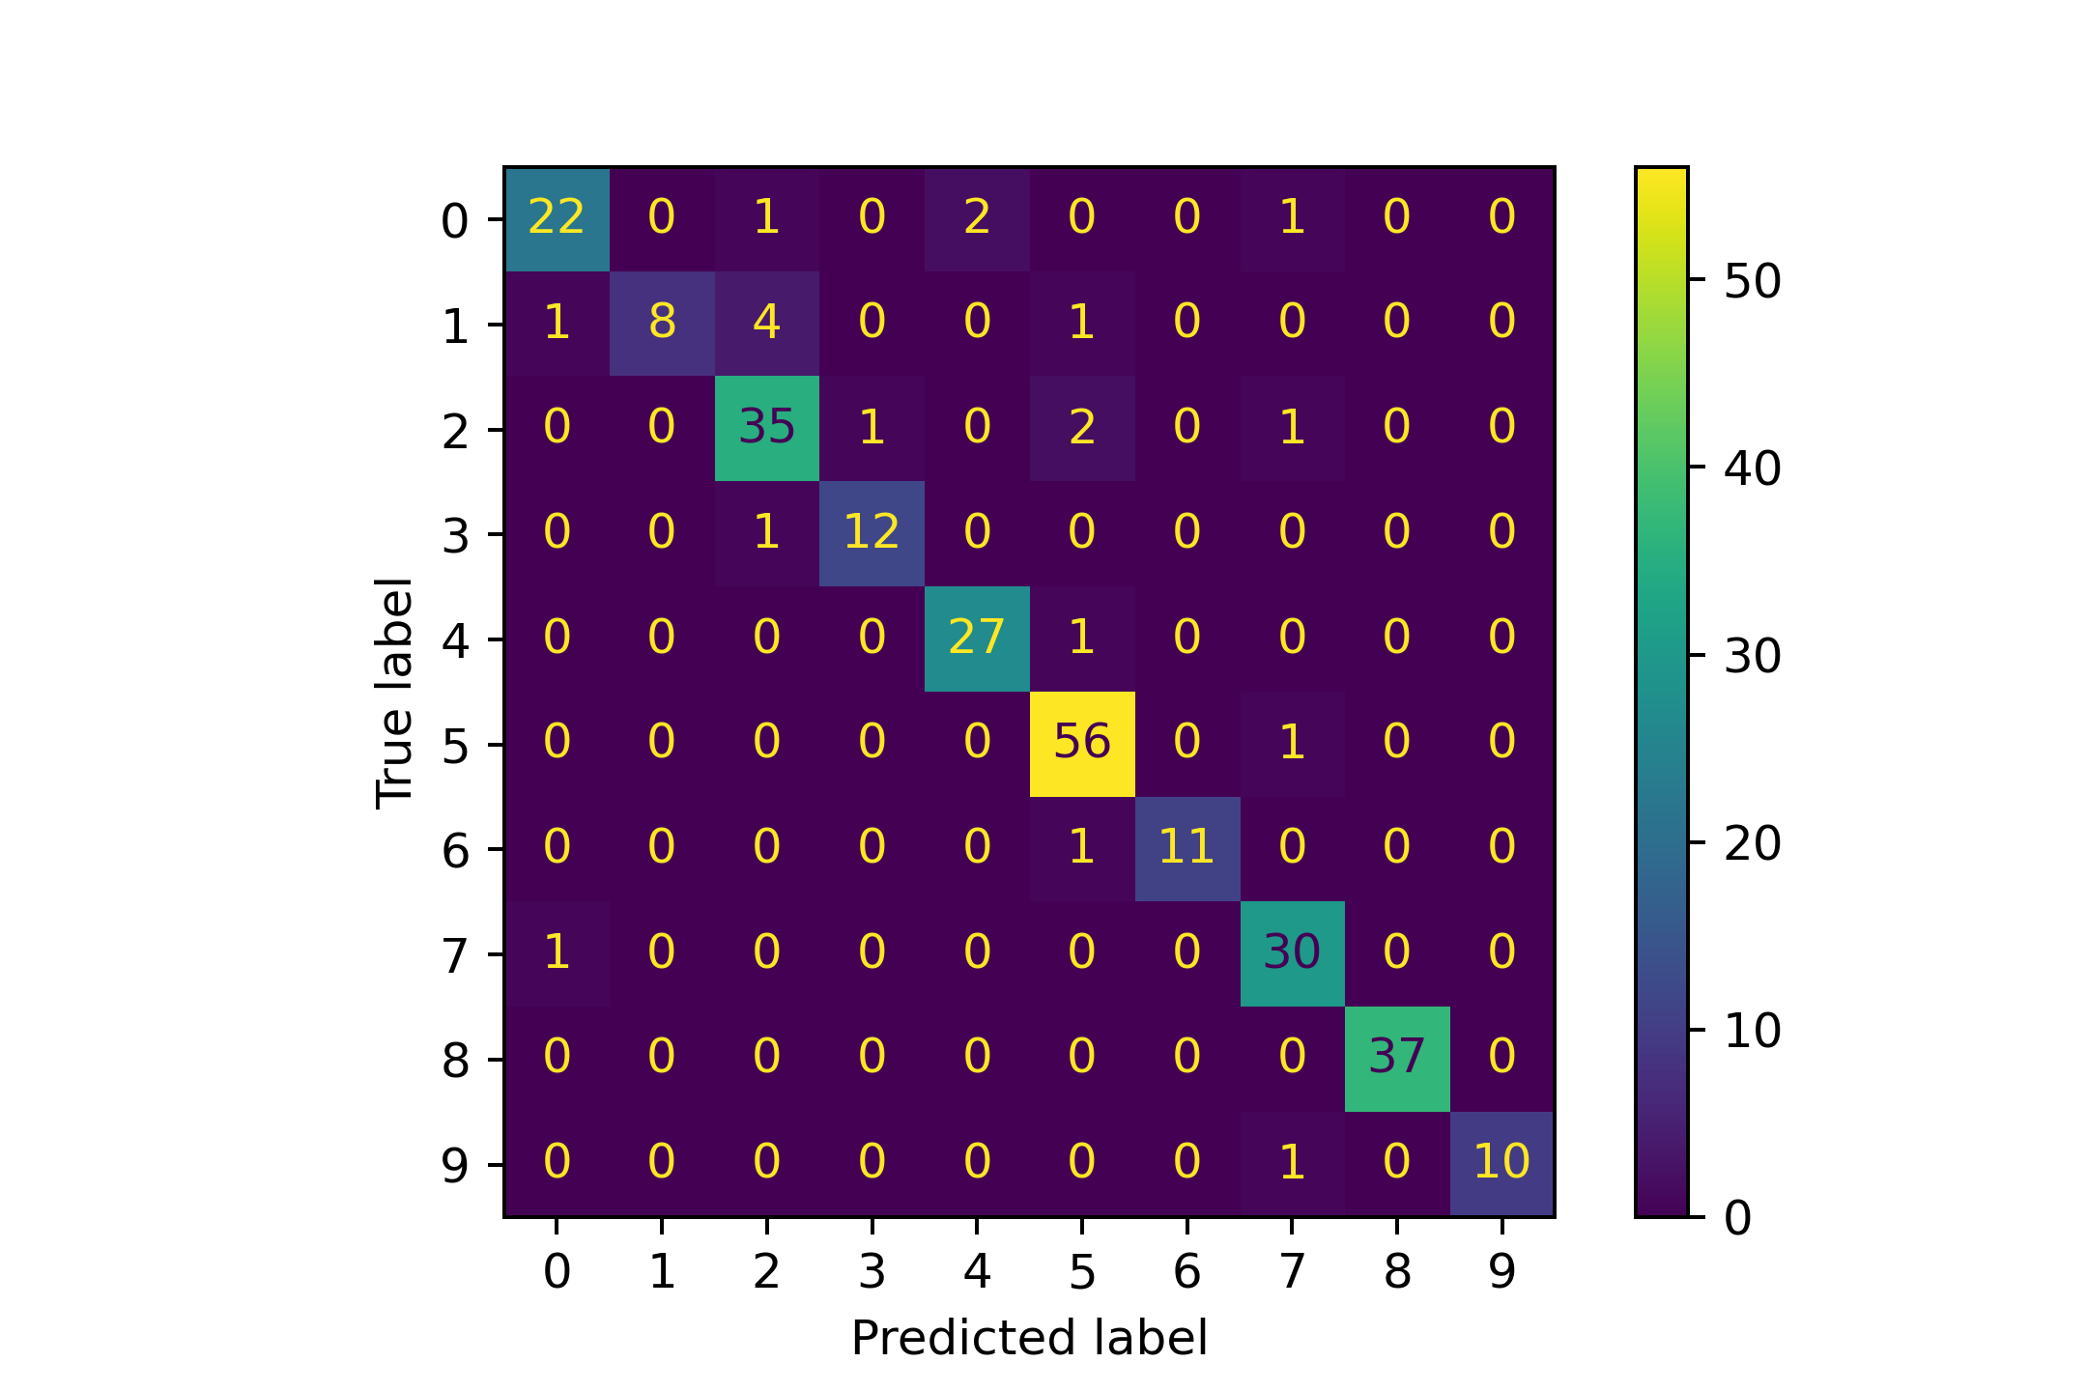
Confusion matrix
 | Predicted label
True label | TP₁ | FN₁₂ | FN₁₃
 | FP₂₁ | TP₂ | FN₂₃
 | FP₃₁ | FP₃₂ | TP₃
(ma trận nhầm lẫn) Can help us see predictions for each class in details
Multiclass classification
TP_{i} (true possitive): the number of instances that are assigned correctly to class c_{i}.
FP_{i} (false possitive): the number of instances that are assigned incorrectly to class c_{i}.
FN_{i} (false negative): the number of instances inside c_{i} that are assigned incorrectly to another class.

Slide 21
Precision and Recall (1)
These two measures are often used in information retrieval and classification
Precision for class c_{i}:
Percentage of correct instances, among all that are assigned to c_{i}.
Recall for class c_{i}:
Percentage of instances in c_{i} that are correctly assigned to c_{i}.

Slide 22
Precision and Recall (2)
To give an overall summary, we can take an average from individual classes.
Micro-averaging:
Macro-averaging:

Slide 23
F₁
Precision and recall provide us different views on the performance of a classifier.
F₁ can provide us a unified view.
F₁ is the harmonic mean of precision and recall, and is computed as:
F₁ tends to be close to the smaller value from {precision, recall}
Large F₁ implies that both precision and recall are large.

Slide 24
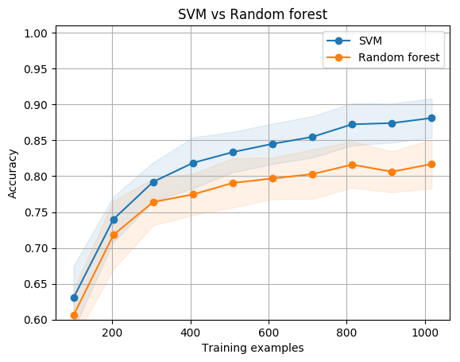
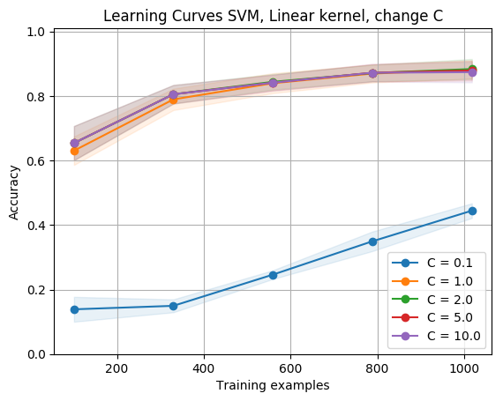
Example: compare 2 methods
Methods: Random forest vs Support vector machines (SVM)
Parameter selection: 10-fold cross-validation
Random forest: n_estimate = 250
SVM: regularization constant C = 1

Slide 25
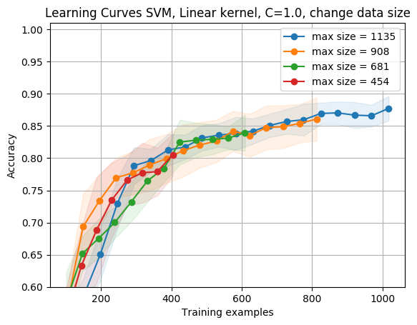
Example: effect of data size
SVM
Parameter: size of training data
Dataset: 1135 news, 10 classes, vocabulary of 25199 terms
10-fold cross-validation
is used

Slide 26
Example: effect of parameters
SVM for news classification
Parameter C changes
Dataset: 1135 news, 10 classes, vocabulary of 25199 terms
10-fold cross-validation is used

Slide 27

Thank you for​ your attentions!​

